Slide 1
OENG1118 Sustainable engineering practice and design
Weeks 3 & 4: Engineering design for sustainability
Engineering design

Slide 2
Course convener
Peter Stasinopoulos
peter.stasinopoulos@rmit.edu.au
57.03.36, City Campus

Slide 3
Engineering design for sustainability: skills
Define sustainable development or regenerative development in the context of your product’s life cycle
Compile non-overlapping sets of design requirements and performance indicators
Develop theoretical targets for the design requirements
Project
Demonstrate each of the 3 skills

Slide 4
Engineering design for sustainability: skills
Incorporate frugal subsystems and processes
Incorporate biomimetic subsystems and processes
Increase eco-efficiency
Increase eco-effectiveness
Identify leverage points using whole system thinking
Follow the optimal design sequence
Optimise the useful lifetime
Project
Demonstrate at least 5 of the skills

Slide 5
Engineering design

Slide 6
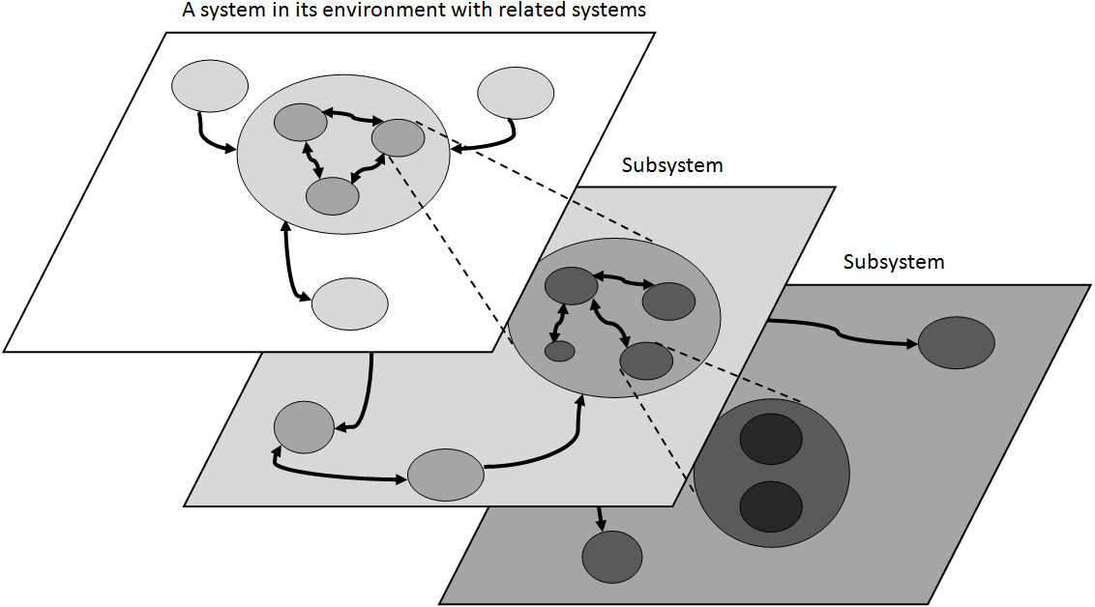
Systems
Time
Space
Life cycle
Production
Use
End-of-life
(Adcock n.d.)
Notes:
Adcock, R. (n.d.) Principles and practices of Systems Engineering, presentation, Cranfield University, p. 8. Available at http://www.incose.org.uk/Downloads/AA01.1.4_Principles%20&%20practices%20of%20SE.pdf. Accessed 27 March 2008.

Slide 7
Engineering design
Phases of engineering design
Definition of Need
Conceptual Design
Preliminary Design
Detailed Design

Slide 8
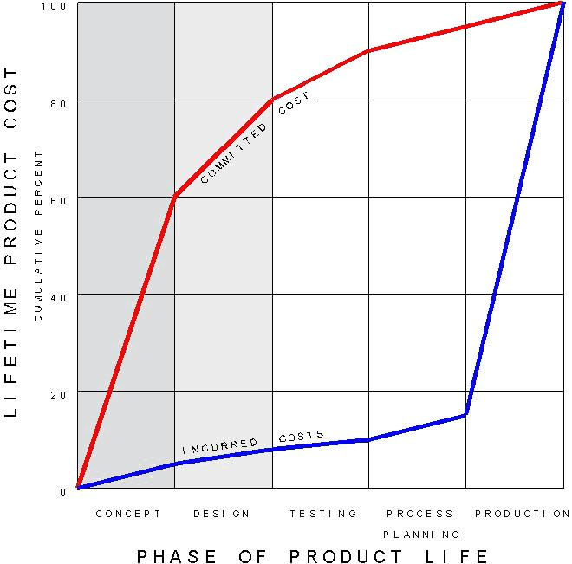
Investment in design
(Anderson 2006)
Notes:
Anderson, D.M. (2006) Design for manufacturability & concurrent engineering: How to design for low cost, design in high quality, design for lean manufacture, and design quickly for fast production, CIM Press. Available at http://www.halfcostproducts.com/dfm_article.htm. Accessed 11 July 2007.

Slide 9
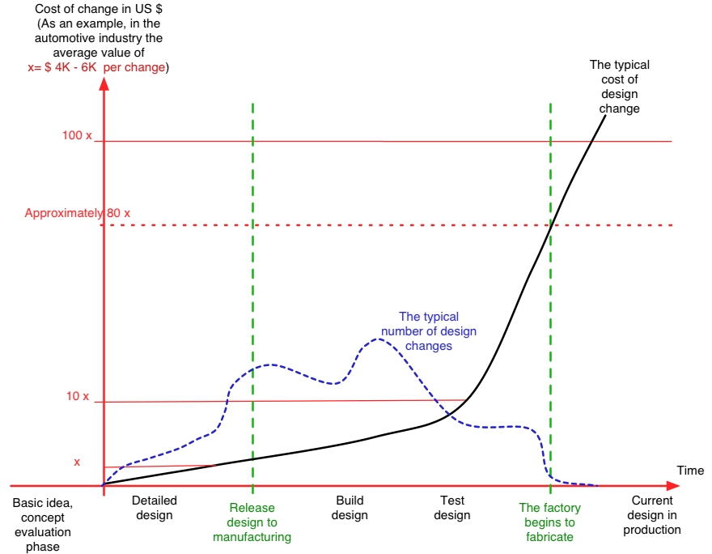
Investment in design
(Anderson 2006)
Notes:
Anderson, D.M. (2006) Design for manufacturability & concurrent engineering: How to design for low cost, design in high quality, design for lean manufacture, and design quickly for fast production, CIM Press. Available at http://www.halfcostproducts.com/dfm_article.htm. Accessed 11 July 2007.

Slide 10
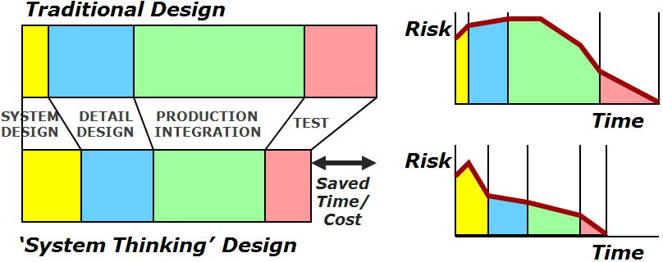
Investment in design
(Honour 2004)
Notes:
Honour, E.C. (2004) Understanding the value of Systems Engineering, Proceedings of the Fourteenth Annual Symposium of the International Council on Systems Engineering, Toulouse, France. Available at http://www.incose.org/secoe/0103/ValueSE-INCOSE04.pdf. Accessed 16 July 2007.

Slide 11
Systems
Activity
Identify the major subsystems of your system
Example – mobile device: user input, user output, frame, energy storage
Example – dwelling: weather protection, lighting, food storage, energy supply
Example – passenger vehicle: propulsion, steering, weather protection, energy supply

Slide 12
Thanks!

Slide 13
Assessment tasks
Week 1-2
Week 3 ________ ________ ________
Week 4 ________ ________ ________
… | …
Week 11 ________ ________ ________
Project
Project
Project-based learning
Lectures: learn fundamental content and skills
Private: apply content and skills to your group project
Tutorials: get feedback on your group project
Private: revise group project based on feedback
Project
Project

Slide 14
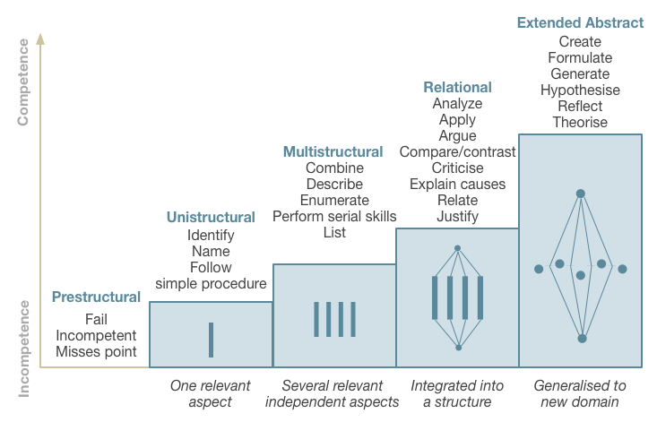
Assessment standards
SOLO taxonomy
Video (4 min)
Text (100 words)
Source: The Australian National University 2014, Unravelling Complexity, The Australian National University, Canberra. http://vc-courses.anu.edu.au/uc/home, viewed 4 March 2014.

